Slide 1
Google Cloud Platform

Slide 2
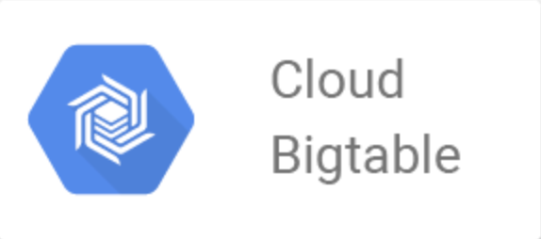
Google Bigtable
Overview
Google Bigtable (Cloud Bigtable) is completely managed and thinly populated database or table which can store billion of rows and thousands of columns.
In other words, cloud table enables you to store data which are very large in size. It stores terabytes or even upto perabytes of data.
Bigtable was developed at Google and it has been in use since 2005 in dozens of Google services.
Credit: https://miro.medium.com/max/574/1*itYNqdwn-4AcW4H876rtUg.pngl
Notes:
Reference for contents : https://cloud.google.com/bigtable/docs/overview

Slide 3
Google Bigtable
Google Bigtable is used for large and analytical operations.
It is key-value database.
Cloud Bigtable is indexed by a single value. Which is known as row key.
it is designed to support systems that requires higher/massive scalability.
Bigtable is ideal for storing big data. It stores single-keyed data with very minimal delay. It supports high read and write throughput at low latency.
In big table, read and write latency is depends upon the geographic location of Bigtable data.
It also serves purpose for MapReduce job , stream analytics and ml applications.

Slide 4
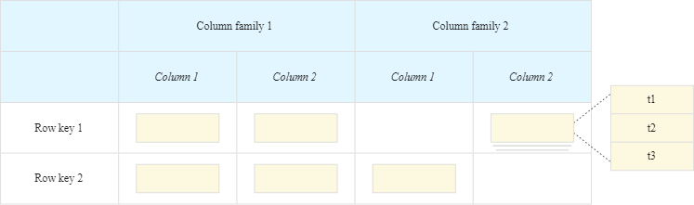
Google Bigtable
Bigtable storage model
Bigtable is a storage model mainly designed for tackling large amount of data over distributed operating system.
Eventhough it is not relational database, it stores data in tabular format.
In big table, data is stored using row, column and timestamp.
Credit: https://cloud.google.com/bigtable/img/storage-model.svgl
Notes:
Reference for contents : https://cloud.google.com/bigtable/docs/overview#what-its-good-for

Slide 5
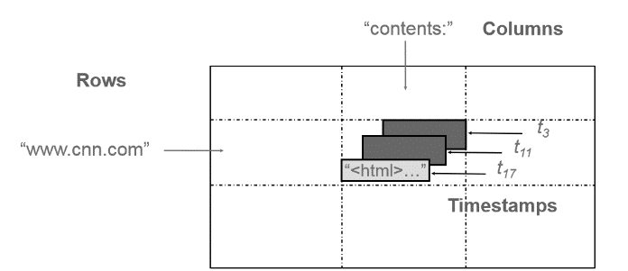
Google Bigtable
in big table, data is stored using row, column and timestamp.
Bigtable is a combination of row, column and timestamp values.
In the Bigtable, each row describes a unique entity and each column stores individual values for row accordingly.
Related columns are grouped together into a column family and each column is identified by a combination of the column family and a column qualifier.
Each qualifier has a unique name within the column family.
Each row/column intersection can contain multiple cells and each cell has unique timestamped version of value. For ex. In the previous figure unique timestamp has shown as a t11,t17 and t3.
Credit: https://miro.medium.com/max/1392/1*VSa7kez83jr_6mn550gDSQ.png
Notes:
Reference for contents : https://cloud.google.com/bigtable/docs/overview

Slide 6
Google Bigtable
Above figure shows how Bigtable can store multiple values (instances) of data in a single cell using timestamp.
For ex. it shows multiple versions of html pages stored at different values of timestamp. This shows the property of multidimention.
Bigtable tables are sparse; if a column is not used in a particular row, it does not take up any space.
Row keys are arbitrary strings up to 64 KB of size. Bigtable maintains data in lexicographical order of row key.
Column keys are also strings having a two level naming structure which has column family and optional qualifiers.
Since Bigtable can store multiple versions of data in a cell it uses timestamp values to index these multiple versions. Timestamp is a 64-bit integer value.
Notes:
Reference for contents : https://cloud.google.com/bigtable/docs/overview

Slide 7
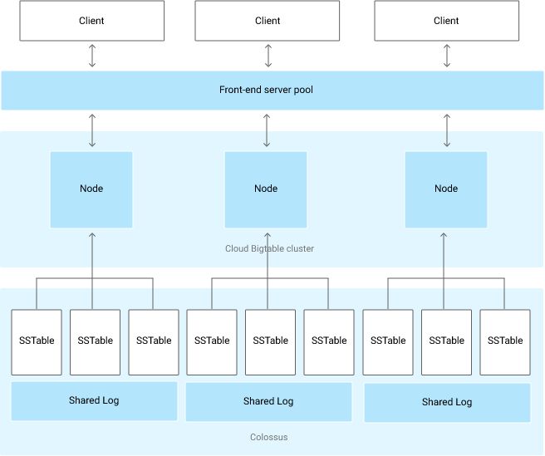
Google Bigtable
Bigtable architecture
Credit: https://cloud.google.com/bigtable/docs/overview#architecture
Notes:
Reference for contents : https://cloud.google.com/bigtable/docs/overview#architecture

Slide 8
Google Bigtable
Initially ,Client requests are diverted to a front-end server before they are sent to the Bigtable node.
Nodes are organized into a Cloud Bigtable cluster of a Cloud Bigtable instance.
Every requests are divided into smaller part .
Each node in the cluster handles a subset of the requests to the cluster.
Add nodes to increase the number of simultaneous requests to handle and maximum throughput according to the capacity of a cluster.
different types of traffic can be sent to different clusters by adding a second cluster.
Table is sharded into blocks of contiguous rows, called tablets similar to HBase regions. Tablets are stored on Colossus, Google’s file system, in SSTable format.
An SSTable is a ordered immutable map from keys to values, and both are byte strings.
Tablet is associated with a specific node.
Writes are stored in Colossus’s shared log as acknowledged.
Notes:
Reference for contents : https://docs.aws.amazon.com/AWSEC2/latest/UserGuide/concepts.html

Slide 9
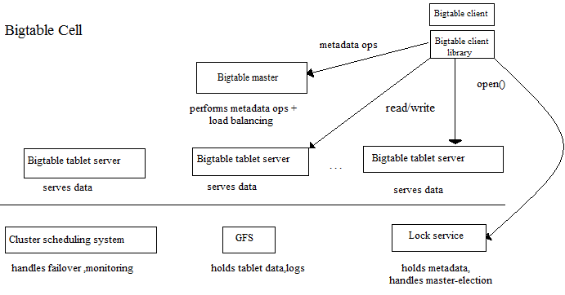
Google Bigtable
Data is never stored in nodes themselves.
Node have pointers to a set of tablets stored on Colossus.
Rebalancing tablets from one node to another is very fast.
Recovery of failure is very fast.
Data is secure even if Cloud Bigtable node fails.
Credit: https://miro.medium.com/max/1382/1*r7O3Qr88-6EOjvtalU7PVw.png
Notes:
Reference for contents :

Slide 10
Google Bigtable
Key features
1.High throughput at low latency.
Bigtable stores very large amounts of data in a key-value store and supports high read and write throughput at low latency for fast access to big data.
Read and write throughput can be changed by changing the location of the tables data.
Throughput scales linearly-you can increase QPS (queries per second) or traffic by adding Bigtable nodes.
2. Flexible, highly scalable and automated replication to optimize any workload
It has a feature of data consistency because it will automatically replicate data which is already written once where needed with eventual consistency.
data consistency, repairing of data, or synchronize writes and deletes are automatic.
Notes:
Reference for contents : https://cloud.google.com/bigtable#section-11

Slide 11
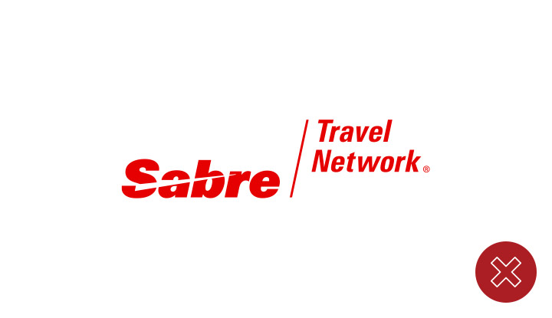

Google Bigtable
Users
Credit: https://cdn.mos.cms.futurecdn.net/kPTwCmCKYJUwGbDbRZr9MX.png
Credit: https://www.sabre.com/brand/assets/img/logo_no_tn2.jpg
Notes:
Reference for contents :

Slide 12
Google Bigtable
User’s description
Macy’s
Macy’s leveraged Google Cloud services to optimize efficiency
Common Services is a strategic initiative at Macy's that leverages Google Cloud managed services.
Sabre
Sabre chose Bigtable and Cloud Spanner to serve more than 1 billion travelers annually.
The companies that partner with us include airlines, travel websites, agencies, and hotels.

Slide 13
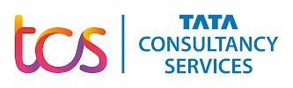



Google Bigtable
Partners
https://lh3.googleusercontent.com/kQhbv1j3NN6BbRXSICIJj3OaHFNCOprz-5yEpWYmLsn4tOuy0hSBM09uaHZe6ss=h50
https://cloud.google.com/find-a-partner/partner/quantiphi-inc
https://lh3.googleusercontent.com/jHGZ7k4BEkRjA3cEoid1LT2ALK83E1nPjJcEu5KqHn2-_xmO1dCcJc-2nsfhOS0=h50
https://cloud.google.com/find-a-partner/partner/cloudbakers

Slide 14
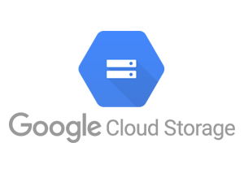
Google colossus(Cloud storage)
Overview
Google cloud storage is quite simple online file storage web service which provide feature of storing and accessing data on google cloud platform.
It allows user to store their data in object format in google cloud.
User can store any object that can not be changed and contain file or data of any data type in google colossus.
In cloud storage, objects are stored in containers called buckets.
All buckets are related with the specific projects and they are grouped under the organization.
Credit: https://miro.medium.com/max/300/1*5GvpNDWSoIfrqaLXe0wwyw.png
Notes:
Reference for contents :https://cloud.google.com/storage?hl=en#section-3

Slide 15
Google colossus(Google cloud)
Key features of cloud storage
Reliable and secure object storage
Transition to lower-cost classes easily : object lifecycle management translates the user data to lower cost storage automatically when all specified criteria are met. that means it takes less space to store big data compare to other services. For ex. When already stored data completes a certain time period it will change automatically.
Multiple redundancy : cloud storage provides large number of storage bucket locations where user can store data at multiple locations with multiple redundancy options. it's upto user to customize data . it's very helpful incase of data lost.
Notes:
Reference for contents : https://cloud.google.com/storage?hl=en#section-1

Slide 16
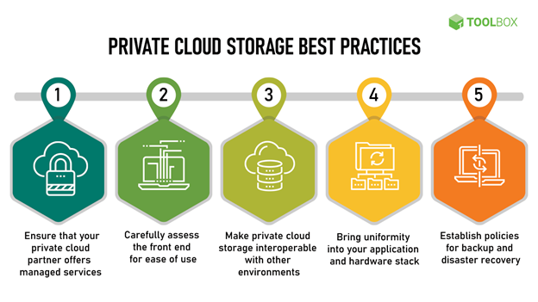
Google colossus(cloud storage)
Types of cloud storage
Private cloud storage
Credit: https://pimages.toolbox.com/wp-content/uploads/2021/07/08124632/Picture1-2.png
Notes:
Reference for contents : https://pimages.toolbox.com/wp-content/uploads/2021/07/08124632/Picture1-2.png

Slide 17
Google colossus(cloud storage)
Private cloud is a computing model that offers a proprietary environment dedicated to a single business entity.
In which the cloud computing services and infrastructure are done privately within a company’s own intranet or data center using proprietary resources.
Private cloud service provides secure cloud option thus, organizations often choose private clouds.
Initially businesses were a little unwilling to migrate to private cloud , it quickly emerged as the most secure cloud model.
Notes:
Reference for contents : https://www.toolbox.com/tech/cloud/articles/what-is-private-cloud-storage/#_001

Slide 18
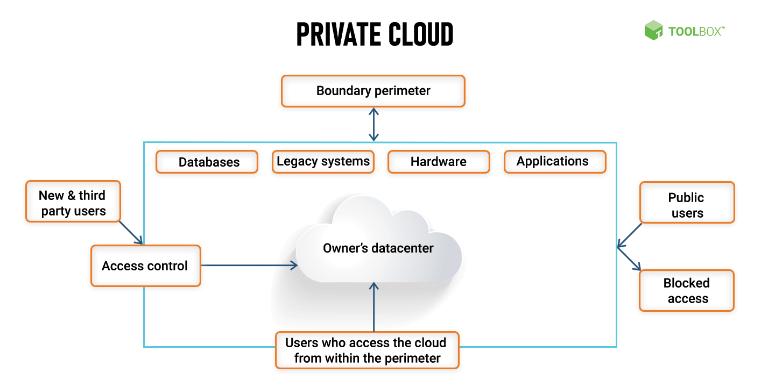
Google colossus(cloud storage)

Slide 19
Google colossus(cloud storage)
Types of private cloud
Virtual private cloud : virtual private cloud is one type of cloud model that offers more control and security. In Virtual private cloud , public cloud provider acts as the service provider and the cloud users act as its tenant. it's a hybrid model of cloud computing.
Managed private cloud: managed private cloud is also a type of private cloud. but in here , infrastructure is not shared between models. it's also knows as dedicated or single-tenant cloud. it is managed by third party vendor.
Notes:
Reference for contents : https://www.toolbox.com/tech/cloud/articles/what-is-private-cloud-storage/#_001

Slide 20
Google colossus(cloud storage)
3. Hosted private clouds : Hosted private cloud vendors offer cloud services in their private data centers and are also provides security management. In a hosted private cloud model, users get access to some additional resources, a support team, high-demand scalability options, as well as a user-friendly dashboard .
4. On premise private cloud: On-premise cloud solutions allow users to host a cloud environment internally unlike hosted private clouds. internal data center is required to host the cloud server . This type of private cloud model is very secure .
Notes:
Reference for contents : https://www.toolbox.com/tech/cloud/articles/what-is-private-cloud-storage/#_001

Slide 21
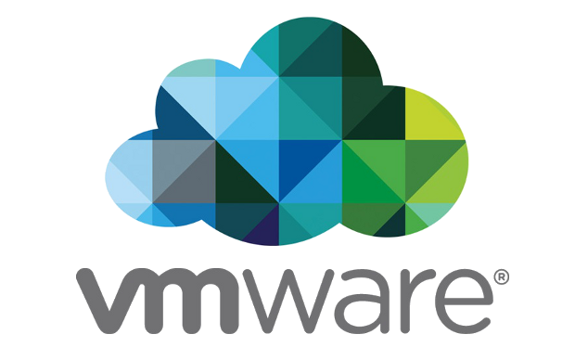
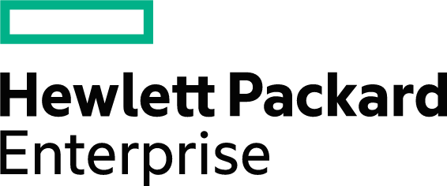

Google colossus(cloud storage)
Example of private cloud provider
Notes:
Reference for contents : https://docs.aws.amazon.com/AWSEC2/latest/UserGuide/concepts.html
https://upload.wikimedia.org/wikipedia/commons/4/46/Hewlett_Packard_Enterprise_logo.svg
Credit: https://cloudcomputing-news.net/wp-content/uploads/sites/2/2022/02/vmware-logo.png
Credit: https://upload.wikimedia.org/wikipedia/commons/thumb/4/48/Dell_Logo.svg/2048px-Dell_Logo.svg.png

Slide 22
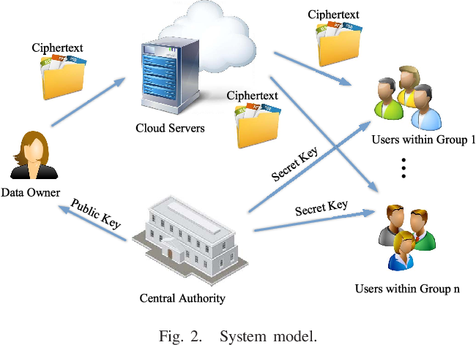
Google colossus(cloud storage)
2. Public cloud storage
Public cloud storage, also called storage-as-a-service or online storage is a service model that provides data storage on a pay-per-use basis.
similar to the way a public utility like electric or gas provides and charges for services.
the services on public cloud are available to anyone who wants to use or purchase them
Public cloud storage usage is generally charged on a per-gigabyte-per-month basis.
Credit: https://d3i71xaburhd42.cloudfront.net/5bf3ad8a5cd835b8f357fde037e51e93aaf01f0a/4-Figure2-1.png

Slide 23
Google colossus(cloud storage)
In public cloud storage , public cloud is operated by a cloud service provider whose services are offered over the internet.
Public cloud helps businesses save on purchasing, managing, and maintaining on-premises infrastructure since the cloud service provider manages the whole system.
Public cloud storage also offer scalable random access memory and flexible bandwidth, which makes it easier for businesses to scale their storage needs.
Features of public cloud storage: cost-effective, highly scalable, universally accessible, offers automatic data backups.
Notes:
Reference for contents : https://www.toolbox.com/tech/cloud/articles/what-is-public-cloud/#_001

Slide 24
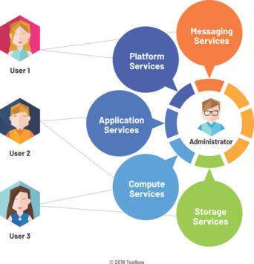
Google colossus(cloud storage)
Function of public cloud storage
In public cloud storage , computer, storage, development platforms, applications are available as a service over the internet.
user can demand these services by their own according to their requirement.
it works based on pay-per-use model.
Features of public cloud :flexibility, scalability and can be accessed simultaneously.
Credit: https://pimages.toolbox.com/wp-content/uploads/2021/07/14133540/How-a-Public-Cloud-Functions.png
Notes:
Reference for contents : https://pimages.toolbox.com/wp-content/uploads/2021/07/14133540/How-a-Public-Cloud-Functions.png

Slide 25
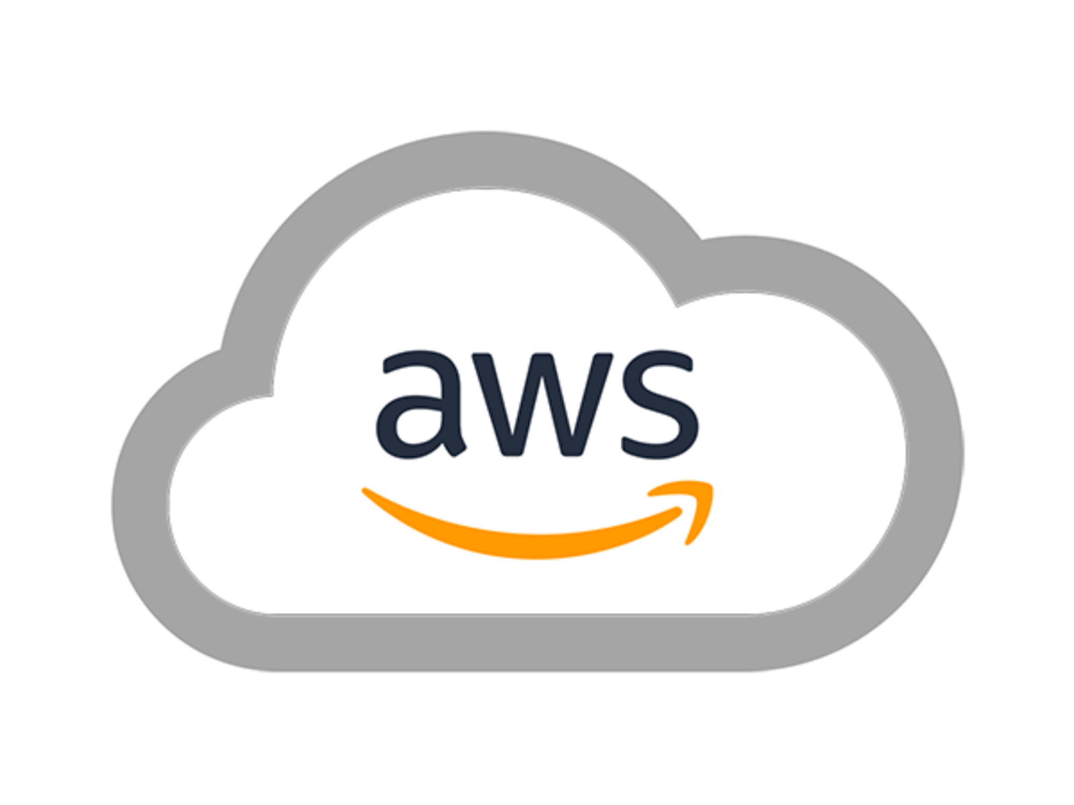
Google colossus(cloud storage)
Types and examples of public cloud storage
Amazon web service :
AWS commonly known as AWS, is a cloud services platform that offers cloud computing infrastructure, database storage, bandwidth, API support, and content delivery.
it also offers cloud services related to networking, analytics and machine learning, the internet of things (IoT), mobile services, development.
Notes:
Image credit : https://futurumresearch.com/wp-content/uploads/2020/01/aws-logo.png

Slide 26
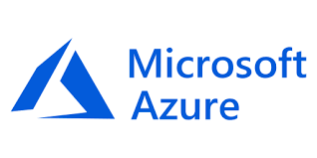
Google colossus(cloud storage)
Microsoft azure
It is a cloud computing platform and an online portal that allows user to access and manage cloud services and other resources provided by Microsoft.
Features of Microsoft azure: faster , enhanced flexibility, security, disaster recovery.
Azure’s services can also be used to replace or supplement your existing on-premise servers.
Notes:
Reference for contents : https://www.hp.com/us-en/shop/tech-takes/top-5-benefits-microsoft-azure
Reference for contents: https://www.toolbox.com/tech/cloud/articles/what-is-public-cloud/#_001

Slide 27



Google colossus(cloud storage)
Partners
Notes:
Reference for contents : https://lh3.googleusercontent.com/lkCFhyEw1ISGg9x1UWud5XJwdmQlGpKWallGMDiSVihZfsh9tdFQOuCSrzAZyrFlUXDyNcUpcouqog=e14-rj-sc0xffffff-h40-w144
Reference for contents : https://lh3.googleusercontent.com/tBNRBbVka80SYTUF89r2HYtt6bulajMdgArYi9Q0pVvf5hi7wQ0v4rFYDrXAxJbZoA9sVFbpqZY8=e14-rj-sc0xffffff-h40-w144
Reference for contents :https://lh3.googleusercontent.com/_hFpTv54qDX-VwL5OhuEw4HnjQxl27y082Qet5vxcm5pTMvTIBrQJBLTF-FeNZ5f2DqGKZmaRvWB7A=e14-rj-sc0xffffff-h40-w144
Reference for contents : https://lh3.googleusercontent.com/7PA-JI6soOil-wjcKMXQMQSjWuByhfziNMGiRlxcsP36YaPZROoTnu5CGC_0as7dL-H38_qqh6Jb=e14-rj-sc0xffffff-h40-w144

Slide 28
Google colossus(cloud storage)
Other storage services
Google drive : google drive can stores your data file, manage, share your personal file.
Persistent disk : persistent disks are durable network storage devices that your instances can access like physical disks in a desktop or a server.
Filestore : it creates a file based workload and stores user data into it.

